Slide 1
L4/5 GROUP 2
Jordan Marks
Alice Baker
Thomas Gibbs
Daniel Pokladek

Slide 2
Logline and target audience

Slide 3
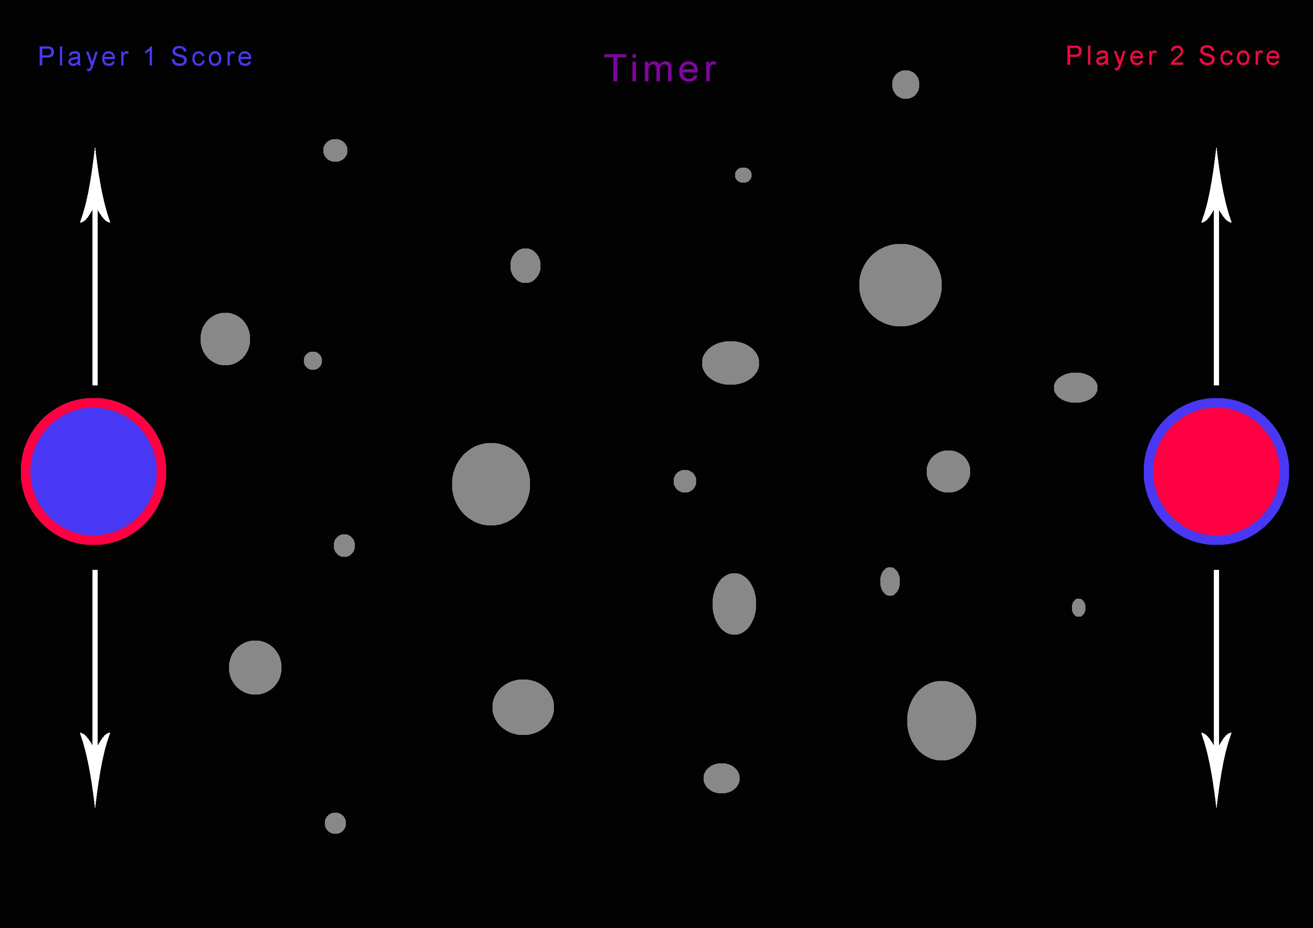
game concept
Eneter text here

Slide 4
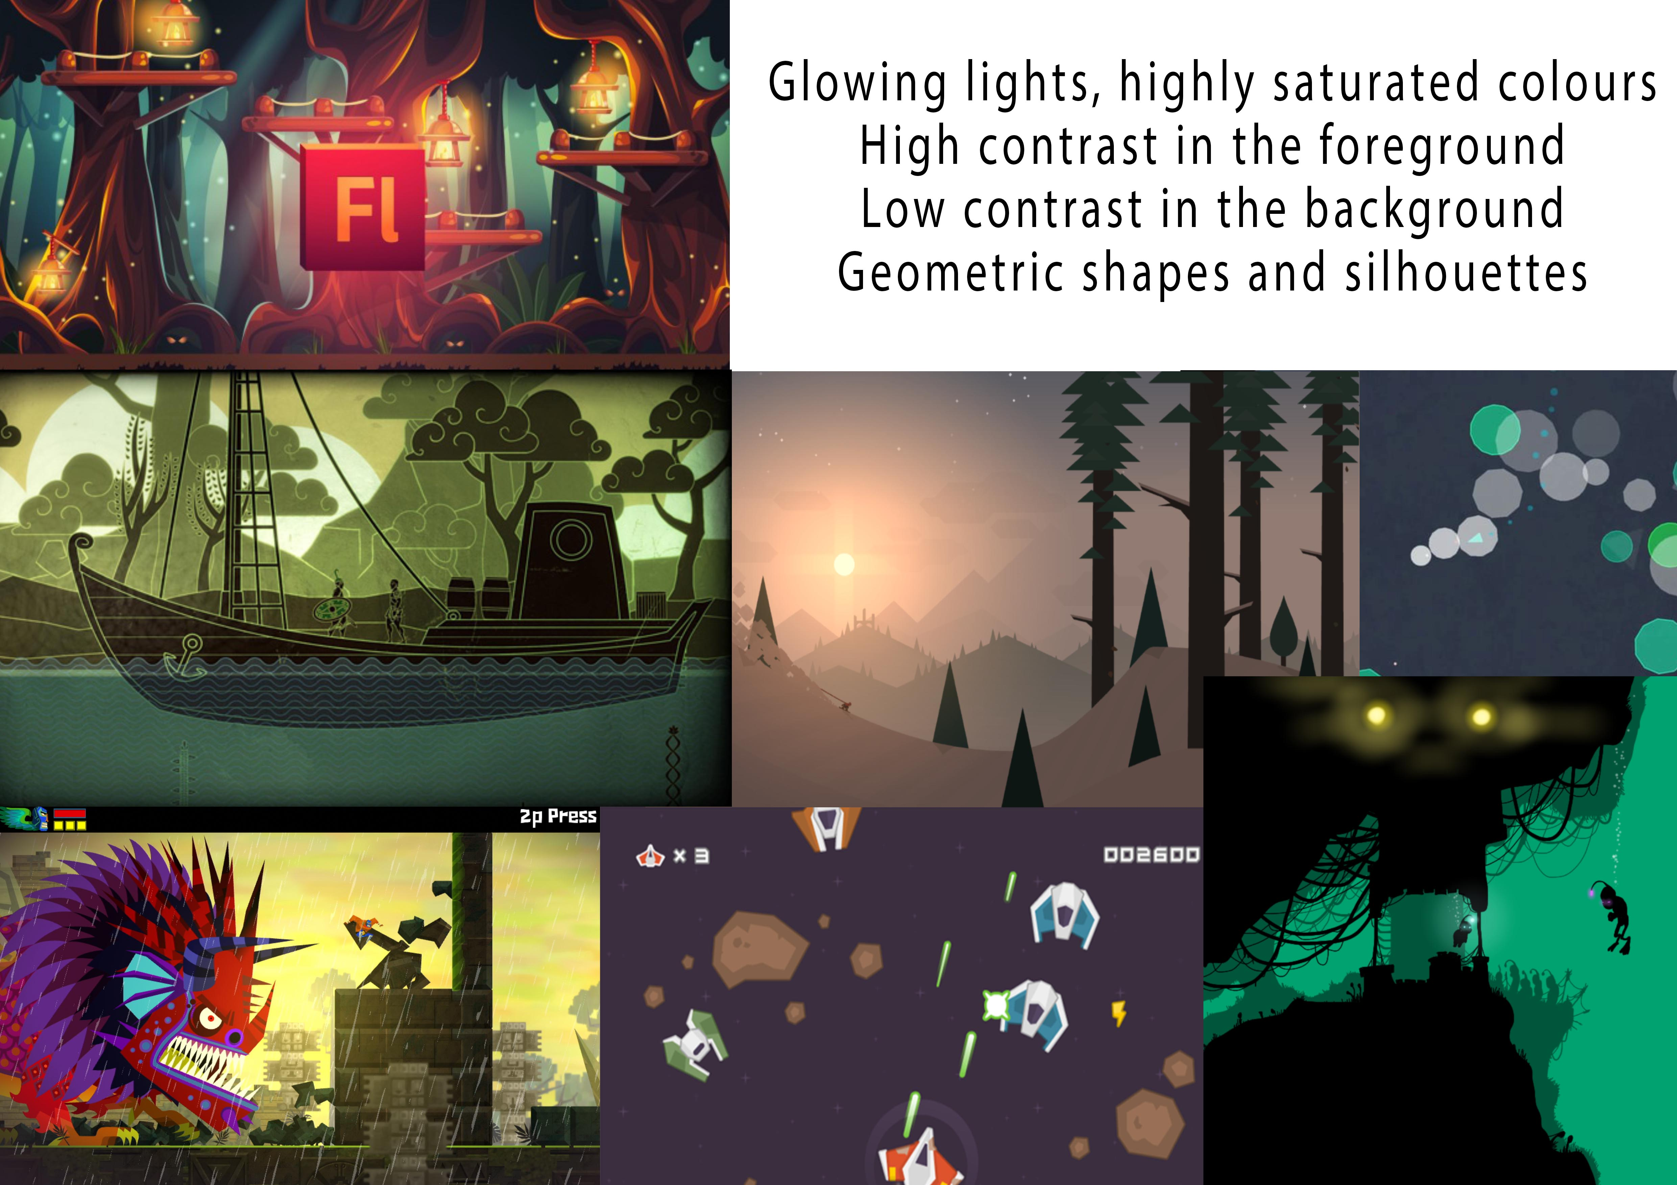
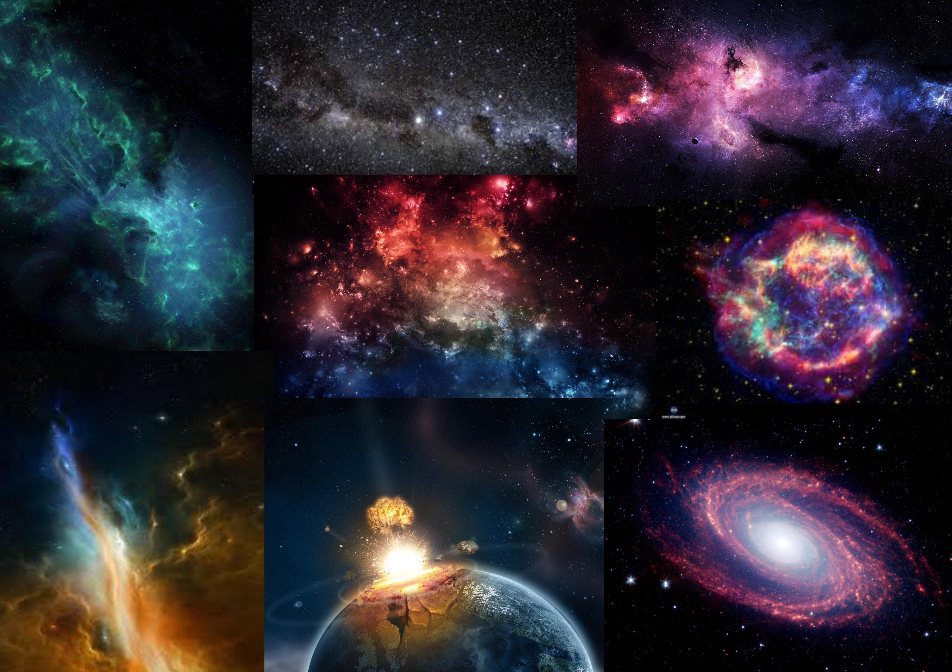
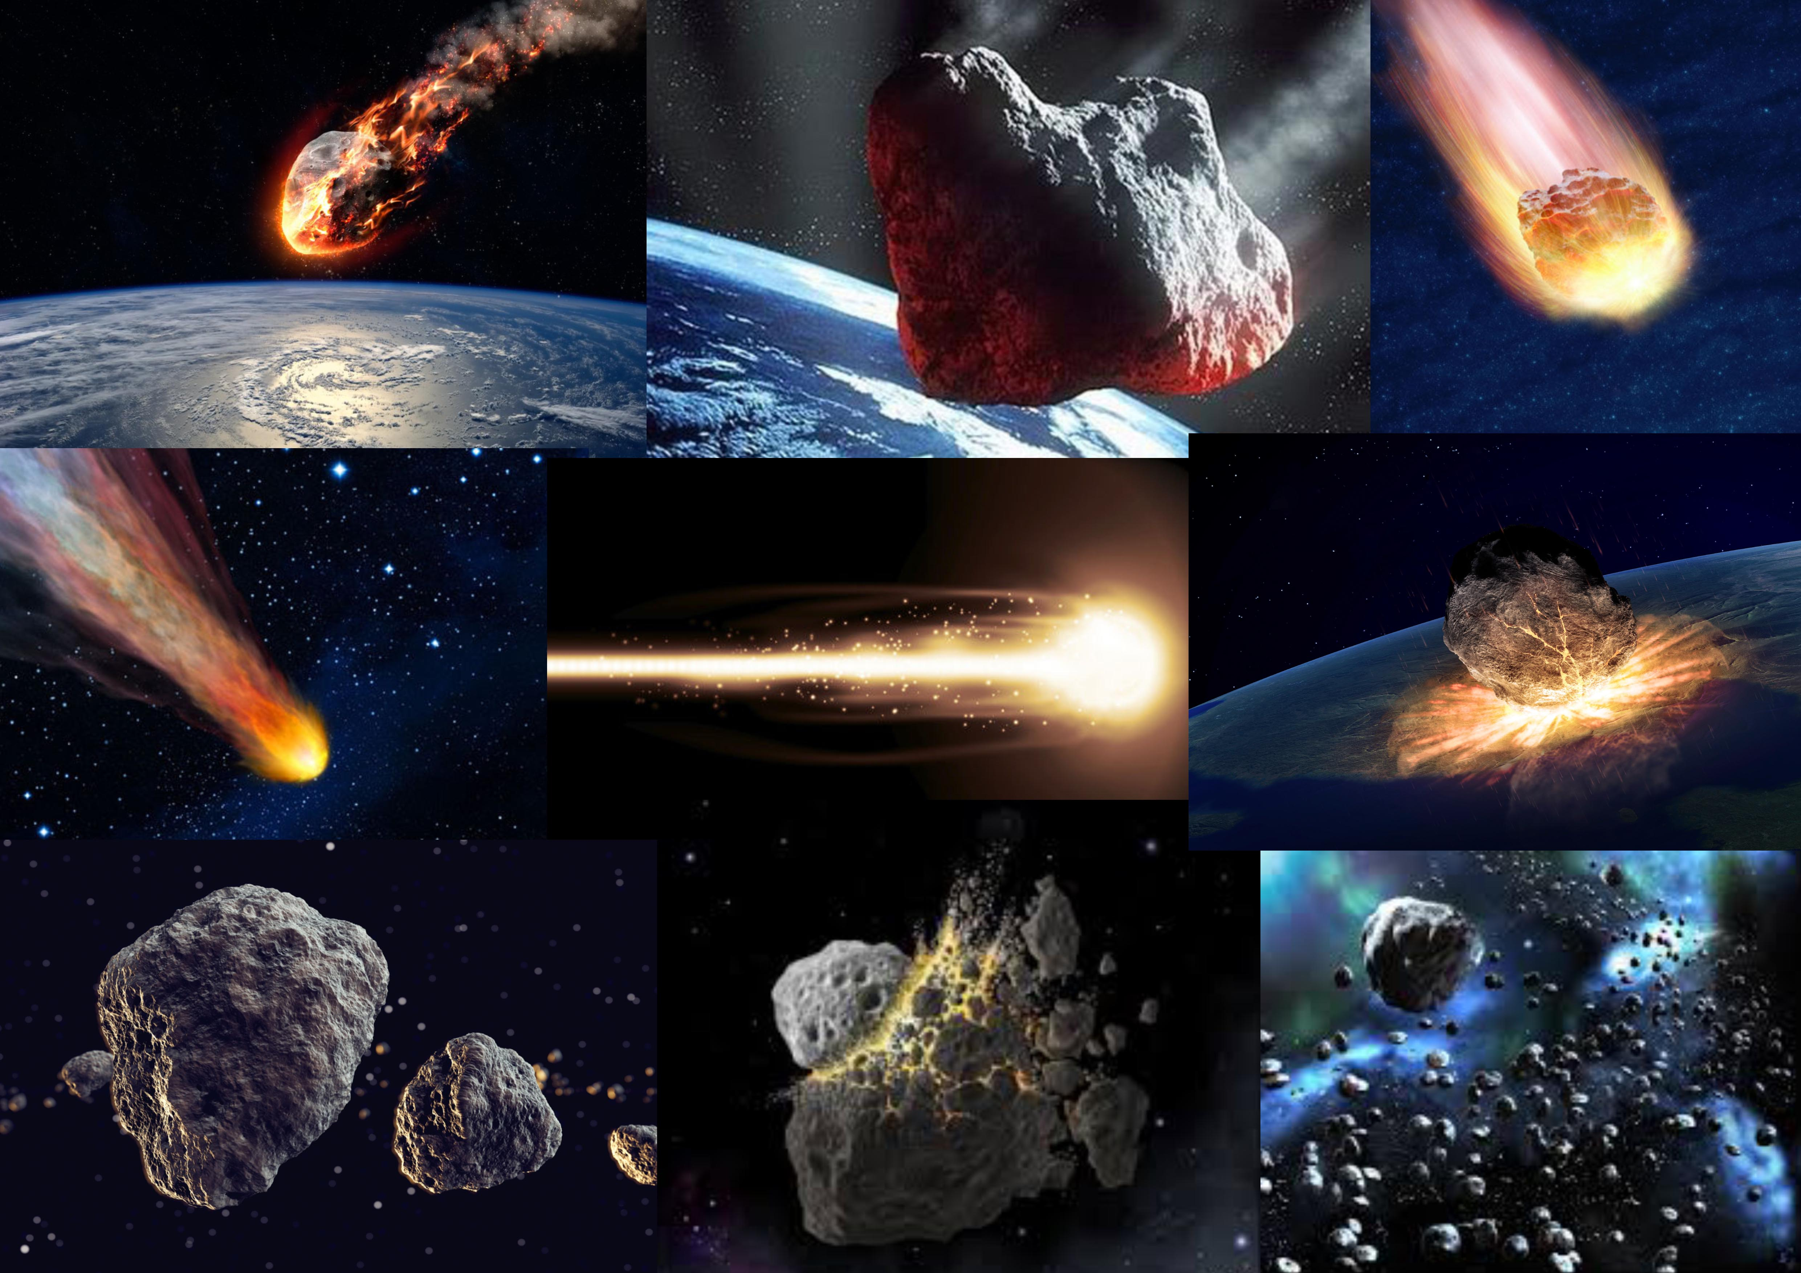

Art style and Moodboard

Slide 5
Physics in the game

Slide 6
Game code ideas

Slide 7
Questions?

